Slide 1
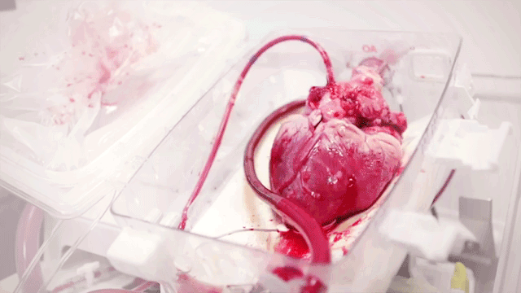
Cardiovascular Disease

Slide 2
Objectives
Anatomy of the Heart
Defining Cardiovascular Disease
Specific Types of Cardiovascular Disease
Incidence
Prevalence
Economic Burden
Attributes
Age and Sex
Race
Culture
Geography
Genetics
Risk Factors
Smoking
Sedentary Lifestyle
Unhealthy Diet
Alcohol
Obesity
Comorbidities
Intervention
Primary
Secondary
Tertiary

Slide 3
Anatomy of the Heart
Cardiovascular System
Supports major organs including : the heart, liver, GI tract, muscles, kidneys, brain, lungs, bones etc.
Basic Flow through the heart
Body via vena cava to right atria
Right atria to right ventricle
Right ventricle to lung via pulmonary artery
Lung to left atria via pulmonary vein
Left atria to left ventricle
Left ventricle to rest of the body
Cardiovascular System Is Key to Connecting
The Whole Body
Above diagram shows major arteries and veins
Flows issues can be systemic and a deficit to the whole body.

Slide 4
Definition
Heart Conditions that includes diseased vessels, structural problems and blood clots or otherwise known as heart disease¹.
Broad Types²
Coronary heart disease
Stroke
Hypertensive Heart Disease
Inflammatory Heart Disease
Rheumatic Heart Disease
Congenital Heart Disease
Deep Vein Thrombosis and pulmonary embolism
Peripheral Arterial Disease
Aortic Aneurysm and Dissection

Slide 5
Specific Heart Diseases (Just a Few)
Rheumatic Heart Disease
Valvular Heart Disease
Aneurysm
Atherosclerosis
Hypertension
Peripheral Arterial Disease
Arrthmyia
Angina
Coronary Artery Disease
Coronary Hearth Disease
Cerebral Vascular Disease
Stoke
Transient Ischemic Attacks
Cardiomyopathy
Pericardial disease
Congenital Health Disease
Health Failure

Slide 6
Incidence
Incidence of heart attack is 580,000 new attacks every year
Cause of 1 in 3 deaths every year
That is one death every 40 seconds
Approximately 17.5 million deaths per year
80% of CVD related diseases are caused by heart attacks and stroke
Greater than 75% of these deaths occur in lower to middle income countries

Slide 7
Prevalence
An estimated 92.1 million US adults have at least 1 type of CVD. By 2030, 43.9% of the US adult population is projected to have some form of CVD.
An estimated 720,000 people in the US suffer a heart attack every year
Coronary Heart Disease is the most prevalent type of Heart Disease (updated 2016)
Build up of plaque in blood vessels

Slide 8
Economic Burden
Costs more than $ 1 Billion per year in Medical Costs and Loss of Productivity
By 2030
Annual medical costs are predicted to rise to more than $818 Billion
Annual lost to productivity cost could exceed $275 Billion

Slide 9
Attributes of Cardiovascular Disease

Slide 10
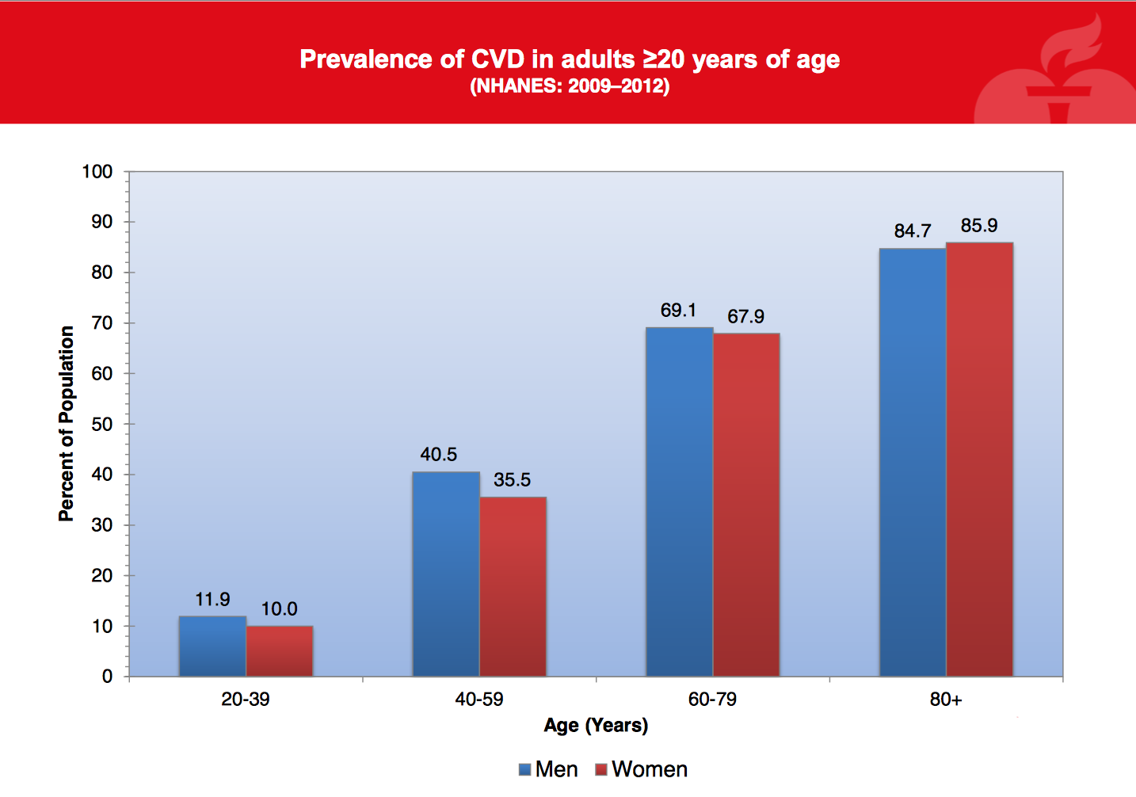
Attributes: Age and Sex
Cardiovascular disease is much more prevalent in men than women¹
Prevalence/Incidence of Cardiovascular Diseases increases with age²

Slide 11
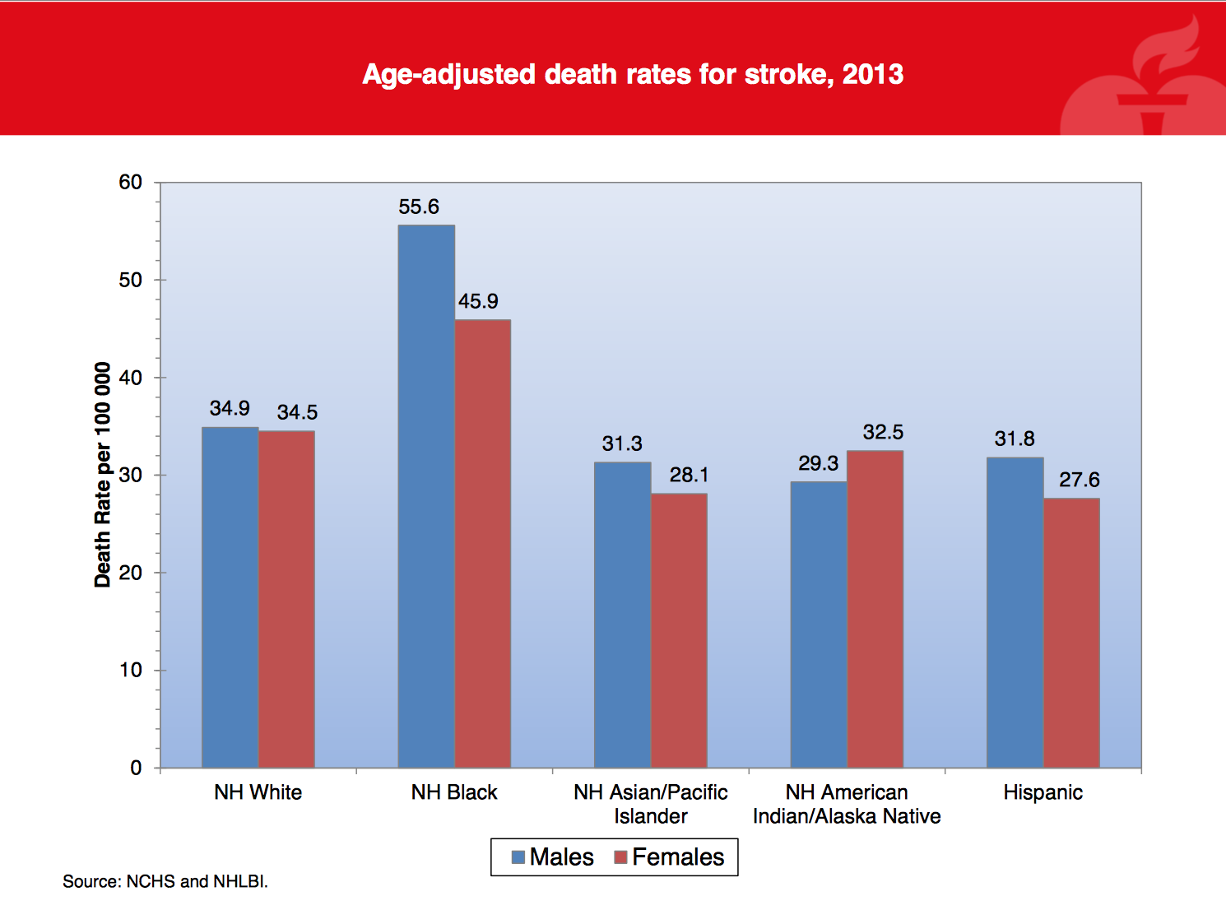
Attributes: Race
More prevalent in African Americans¹
"Racism and cardiovascular disease in African Americans²”
Interesting article that describes how racism in America has shaped the increased prevalence of cardiovascular disease given the health disparity that exists between races.

Slide 12
Attributes: Culture
Smoking
Popularized by celebrities, movies
Thought of as cool
Perpetuated by health disparities¹
Mediterranean Diet²
High mean lifespan
Low rates of prevalence for cardiovascular disease
Southern Culture³
Historically economically disadvantaged
Typically fried foods that contribute to heart disease risk

Slide 13
Attributes: Geography
More Prevalent in the Southern States
Concentrated Prevalence in Louisiana, Alabama and Mississippi.

Slide 14
Attributes: Genetics
Known Genetic Loci
The APOE Gene
Heritability greater than 50%
Controls LDL cholesterol
Contributes to the build-up of plaque
LDL Receptor Gene
Can lead to a build-up of cholesterol
ApoB100
Contributes to LDL binding
Proprotein Convertase Subtilisin/Kexin 9
Mechanism Unknown
Known to contribute to cholesterol build-up
ATP-Binding Cassette Transporter 1
Protein that regulates cellular transport of cholesterol

Slide 15
Attributes/Risk Factors: Adverse Behaviors
Sedentary Lifestyle¹
Unhealthy Diet
Obesity
Alcohol
Tobacco Use

Slide 16
Risk Factor: Smoking
Why is smoking bad?¹
Every puff has 10¹⁵ free radicals
Been observed to cause intimal-medial thickness of the carotid artery
Vascular dysfunction
A result of EDV or endothelium-dependent vasodilation
endothelial inflammation
increased levels of multiple inflammatory markers including C-reactive protein, interleukin-6, and tumor necrosis factor alpha that recruit leukocytes
lipid modification
Not well understood
Thought to be a caused by insulin resistance in smokers
Cigarette smoke causes oxidative modification in LDL

Slide 17
Risk Factor: Sedentary Lifestyle
Exemplified by study with metabolic syndrome
Metabolic syndrome defined by abnormal glucose metabolism, being overweight and having abdominal fat, mild dyslipidemia and hypertension.
Study found that those with metabolic syndrome were 2.6 times more likely to die of CHD after adjusting for other conventional cardiovascular risk factors¹.
Evidenced further by an study done on increased physical activity
Done on 337 patients with type II diabetes
58% reduction of type II diabetes for 2.8 years, for patients who lost 4 kgs of body weight and an increase of 8 MET-h/wk in physical activity²

Slide 18
Risk Factor: Unhealthy Diet
Increase in Unhealthy Diets as the World becomes more Globalized¹
Thanks to Coca-Cola, McDonalds, Pepsi
Paper traced three different cultural movements
Oriental- high intake of tofu and soy and other sauces
Western- high in fried foods, salty snacks, eggs, and meat
Prudent- high in fruit and vegetables
Inverse relationship/risk between prudent lifestyle and MI
Fats and Processed Meats²
Used a cohort diverse in ethnicity
Found that increased intake of the above mentioned foods caused there to be a greater risk of cardiovascular disease
Again found a whole grain and fruit diet to be at lower risk for CVD

Slide 19
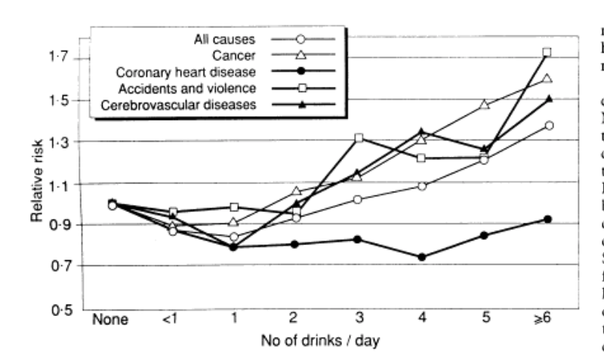
Risk Factor: Alcohol
Studies find a U-shaped curve¹²
Moderate amounts of alcohol are actually a protective factor against CVD
Based on observational study
No ”scientific” or biological proof
Wine Paradox³
Paradoxical relationship in France with high intake of fats with low CVD mortality
Found that 20-30 grams of red wine per day can reduce CVD by 40%
Attribute to reduction in platelet aggregation when drinking alcohol

Slide 20
Risk Factor: Obesity
Obesity¹
Has several comorbidities
Hypertension
Type II Diabetes
Dyslipidemia
Obstructive sleep apnea
Several Other Cardiovascular Disorders
One Mechanism Starling’s Law being shifted left
Obesity causes an increased stroke volume for the heart
With an increased stroke volume, the heart rate is increased slightly
Increased work load on the heart then leads to left ventricle dilation and then left atrial dilation

Slide 21
Comorbidities

Slide 22
Comorbidities: Renal Insufficiency
About a quarter of chronic kidney disease patients also have congestive heart failure
Increases as kidney function deteriorates
Renal insufficiency is the best indicator for CVD-related mortality

Slide 23
Comorbidities: Diabetes
High blood sugar damages blood vessels and nerves in the circulatory system
Extended exposure to diabetes and poorly controlled disease increase risk of developing heart disease
Leading cause of death in adults with diabetes is heart attack or stroke
Adults with diabetes also more likely to have high blood pressure and blood cholesterol

Slide 24
Comorbidities: COPD
Chronic Obstructive Pulmonary Disease (COPD) and heart attacks share some symptomology, specifically shortness of breath
COPD patients significantly more likely to suffer sudden cardiac death (SDC) with or without presence of previous heart disease

Slide 25
Interventions

Slide 26
Intervention: Exercise
Primary prevention
AHA Recommendation For Overall Cardiovascular Health: At least 30 minutes of moderate-intensity aerobic activity at least 5 days per week for a total of 150 OR At least 25 minutes of vigorous aerobic activity at least 3 days per week for a total of 75 minutes; or a combination of moderate- and vigorous-intensity aerobic activity AND Moderate- to high-intensity muscle-strengthening activity at least 2 days per week for additional health benefits. For Lowering Blood Pressure and Cholesterol An average 40 minutes of moderate- to vigorous-intensity aerobic activity 3 or 4 times per week

Slide 27
Intervention: Diet
Avoid saturated and trans fats
Linked to high cholesterol in blood
Unsaturated fats and essential fatty oils are not an issue, but should not exceed 37% of diet
Avoid too much sodium
Linked to high blood pressure
Fruit and vegetable consumption encouraged
Whole grain consumption encouraged
Folic acid, B vitamins, fiber
Fish consumption linked to decrease in CVD risk
Regular nut consumption encouraged
Soy proteins linked to decrease in blood lipid levels
Alcohol in moderation linked to decrease in CVD risk
Primary prevention

Slide 28
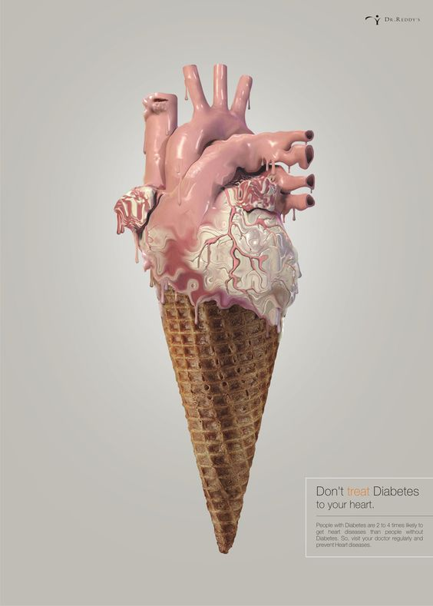
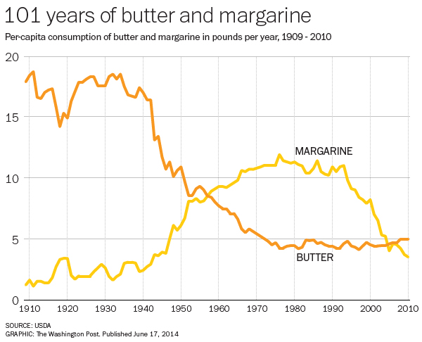
Intervention: Diet PSAs

Slide 29
Interventions: Aspirin
Men aged 45-79 and women aged 55-79 are recommended to use aspirin as a preventative measure
Data are inconclusive for those over 80
Men younger than 45 and women younger than 55 are not recommended
Optimal dose unknown, but smaller amounts (75 mg/day) may have lower chances of negative gastrointestinal side effects
Primary-and-half prevention

Slide 30
Intervention: Free Public Blood Pressure Monitoring
Providing patients access to blood pressure monitors in comfortable setting combined with professional recommendations allowed them to better control hypertension
Primary/secondary prevention depending on the patient

Slide 31
Intervention: Screenings
Recommended to screen for any number of things:
Abdominal aortic aneurism
Carotid Artery Stenosis
Coronary Heart Disease – electrocardiography
Lipid disorders
High blood pressure
Secondary prevention

Slide 32
Interventions: Behavioral Counseling
Primary care providers of those who are overweight or obese with additional CVD risk factors are recommended to refer them to dietary behavioral counseling
Behavioral counseling has shown net benefit results as a form of secondary prevention, but is not generally considered primary care
Secondary prevention

Slide 33
Intervention: Engaging Community Health Workers
Community health workers are trained in the specific culture of their environment
Leveraging their relationship with the constituents could be more helpful than the larger public health workforce
Secondary prevention

Slide 34
Interventions: Medication
Angiotensin-converting enzyme (ACE) Inhibitors /nitroglycerine
Dilates blood vessels to reduce blood pressure
Beta Blockers
Slows heart rate, reduces blood pressure, reduces abnormal heart rhythms
Diuretics
Reduces body fluid
Tertiary prevention/treatment

Slide 35
Interventions: Hospital Treatments
Stint placement
Bypass surgery
Shock therapy
Cardiopulmonary resuscitation (CPR)
Pacemakers
Tertiary prevention/treatment

Slide 36
Interventions: Hospital Treatments

Slide 37
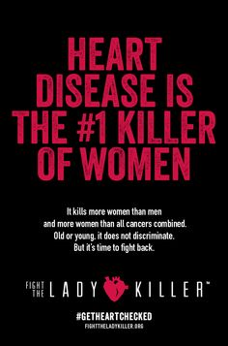
Intervention: PSAs

Slide 38
Intervention: PSAs

